Slide 1
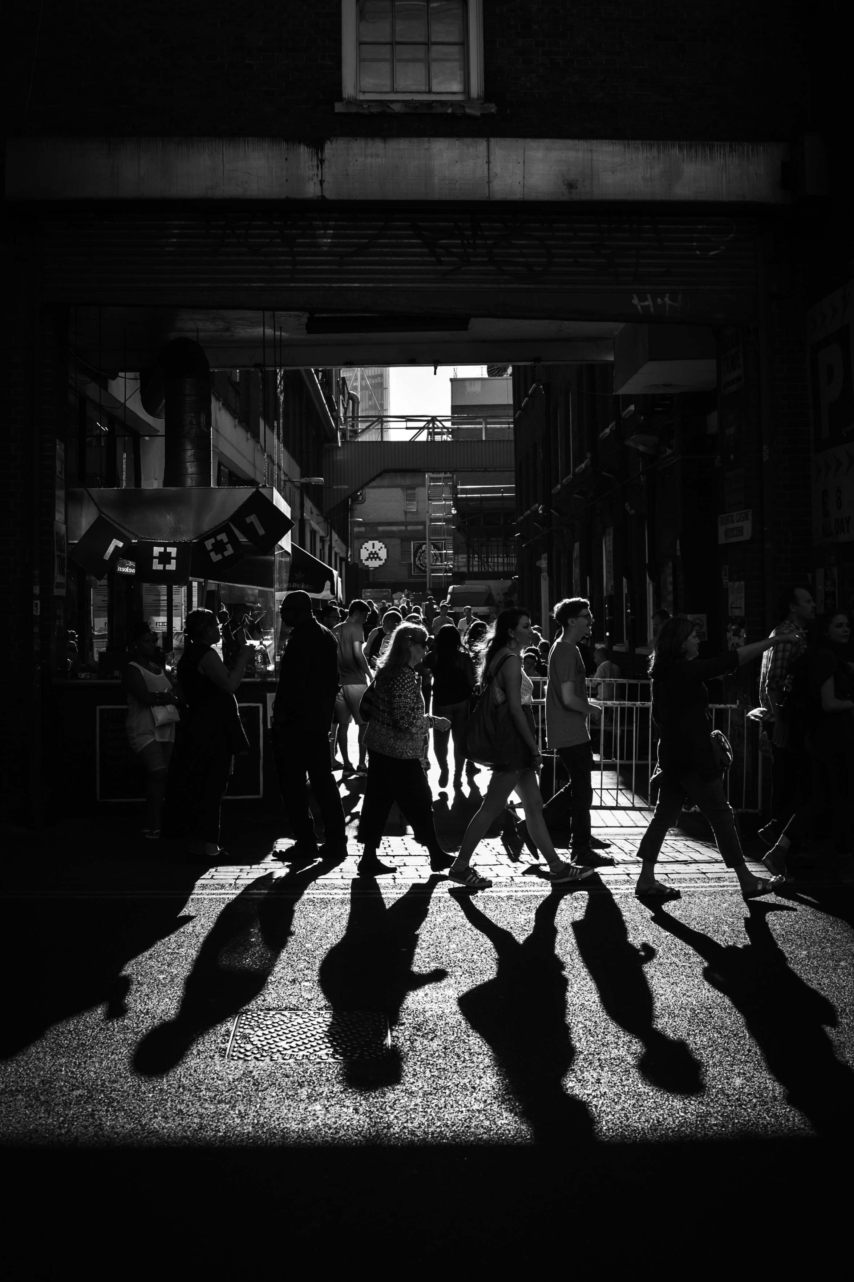

Documenting
Coding in Public workshop
2024
Copyright © 2021. Created by Computational Social Science Training Team, UK Data Service.

Slide 2
Table of Contents
Braaaaaaaaaaaaaaiiiiiiiiiiiiiiiinsssssss
GTD
Incentives
Documentation must match the purpose
When to stop documenting
Modern technological change
Q&A
Breakout #2

Slide 3
Braaaaaaaaaaaiiiiiiiiiiiiiinsssssss

Slide 4
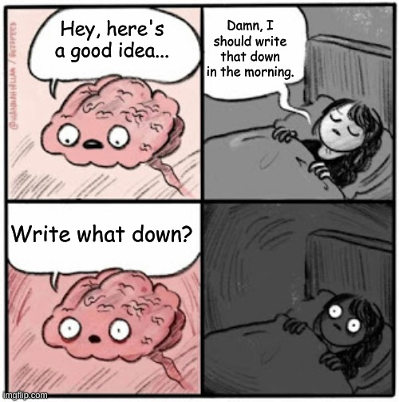
Brains are good for
Having ideas.

Slide 5
Brains are not so good for
keeping or communicating ideas.
At least not modern and/or literate brains. (Huettig, Kolinsky & Lachmann, 2018; Demoulin & Kolinsky, 2016).
So you must learn to document!
Notes:
So (modern) people need to document, which helps reproducibility (among other things) because if you did not write it down you may have lost it.
Lost an idea or who the idea came from
Lost a step in your research process or the reasoning behind why you did that step
Lost who did what, where you sent the article, the funding bid that you wanted to apply to, who has accepted your proposal, etc.
WRITE IT DOWN!
I use an adaptation of the GTD, or Getting Things Done, method.
Other processes are available.

Slide 6
GTD

Slide 7
GTD has 5 (ish) steps and works iteratively
ORIGINAL
Capture
Clarify
Organize
Do
Reflect
Repeat.
MINE
Capture
Combine and/or sort
Clarify/refine
Organize
Action (do and/or schedule)
Reflect
Repeat regularly

Slide 8
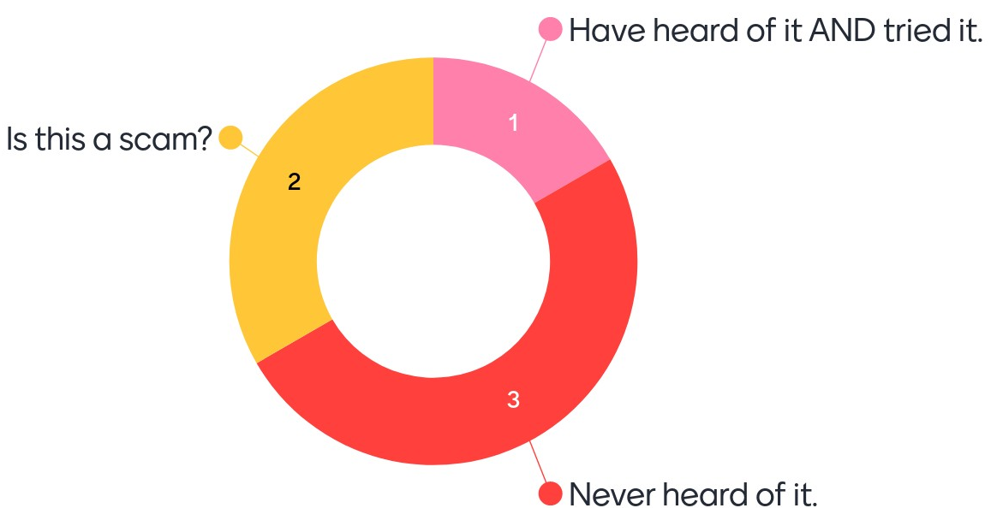
Have you heard of GTD?

Slide 9
Capture
Things to capture
Articles
Social media posts
Contacts
Ideas/questions
Emails/messages
Images
Ways to capture
(smart) Notebooks
Browser extensions
Camera (with handwriting-to-text tool?)
Dictaphone/AI assistant
Notes/To-Do/Reminders app
Meeting recording/transcription
Brainstorming/mind-mapping tool
Notes:
Lots of other options! Plus ways to link them together.
Different tools will be more appropriate for different people and/or different situations

Slide 10
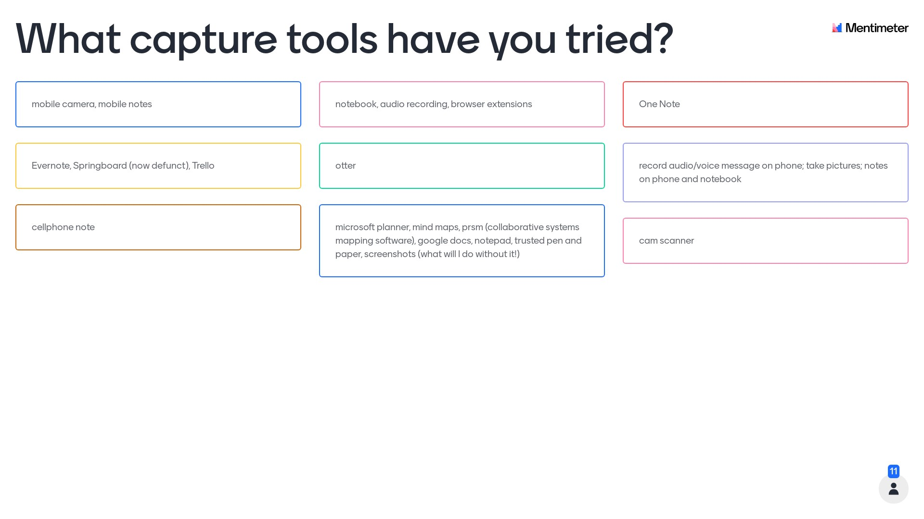
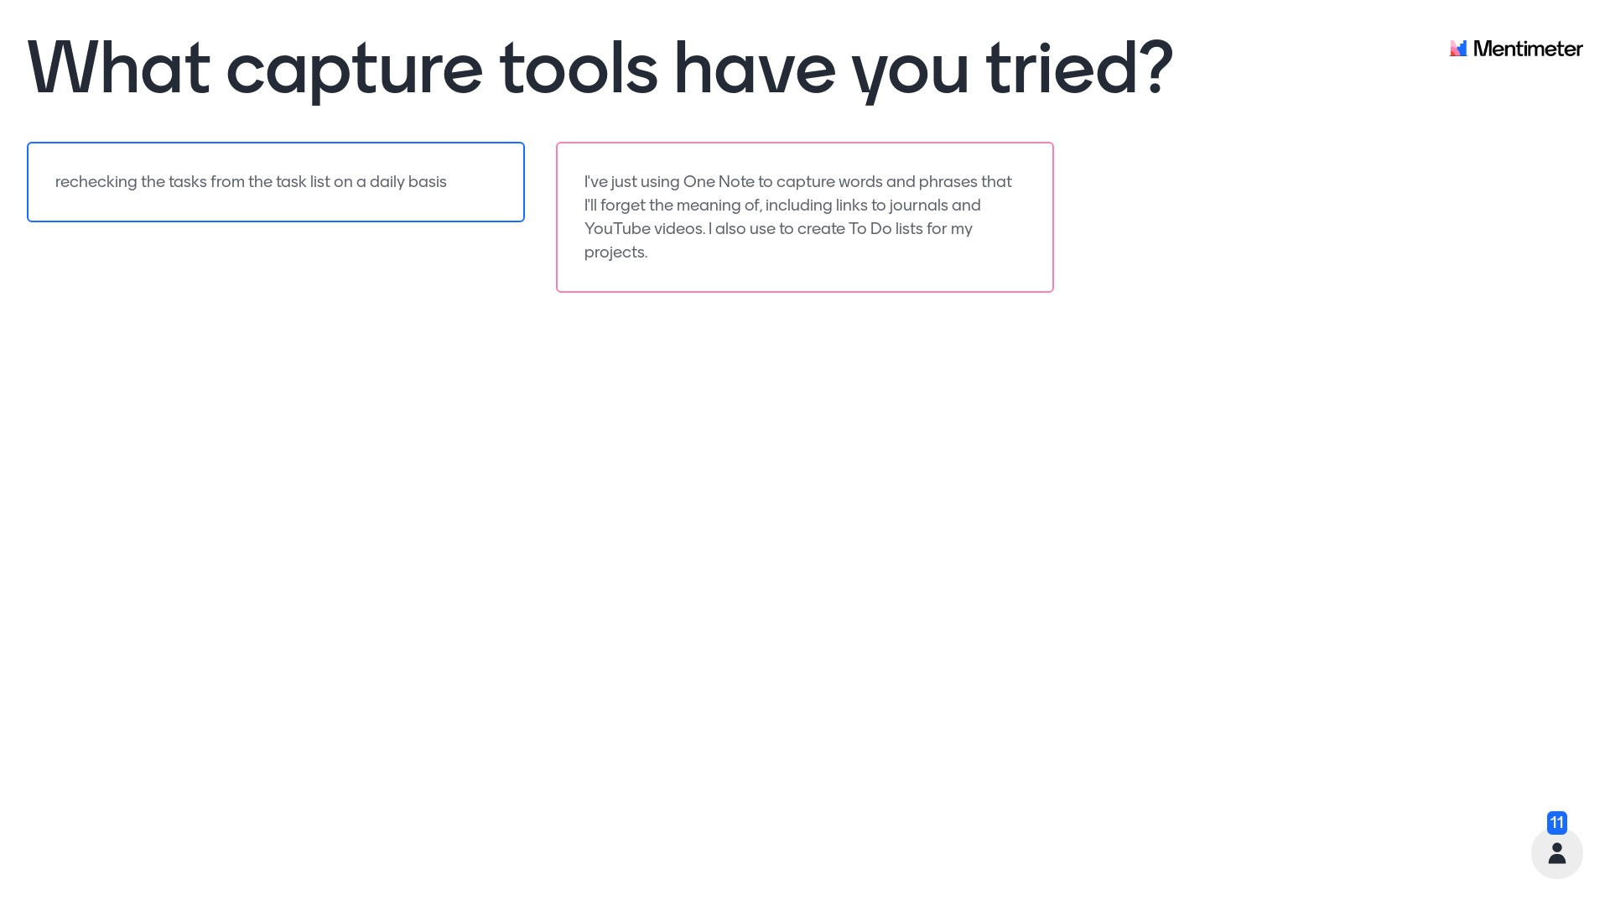
What capture tools have you used/hear of?

Slide 11
Do NOT
assume you’ll remember
evaluate its worth in the moment
get embarrassed about capturing this thing

Slide 12
Combine
Schedule time to regularly check your capture tools to put the things you have captured in better/central/long term places.
Automate when possible, build habits for non-automatable
Always look for better automation and/or habits

Slide 13
Sort honestly
Schedule regular sorting time.
Read everything in your central place and ask yourself:
Do you understand it? If no, delete it.
If yes, ask yourself: Will you use it in the next 6 months?
If no, archive it (searchable, not binned, low effort)
If yes, sort it by
* Moving it to other places/folders/apps/etc.
* Tag/label/rename
* Link to other things (as appropriate)
Notes:
Also delete if this thing is clearly a duplicate

Slide 14
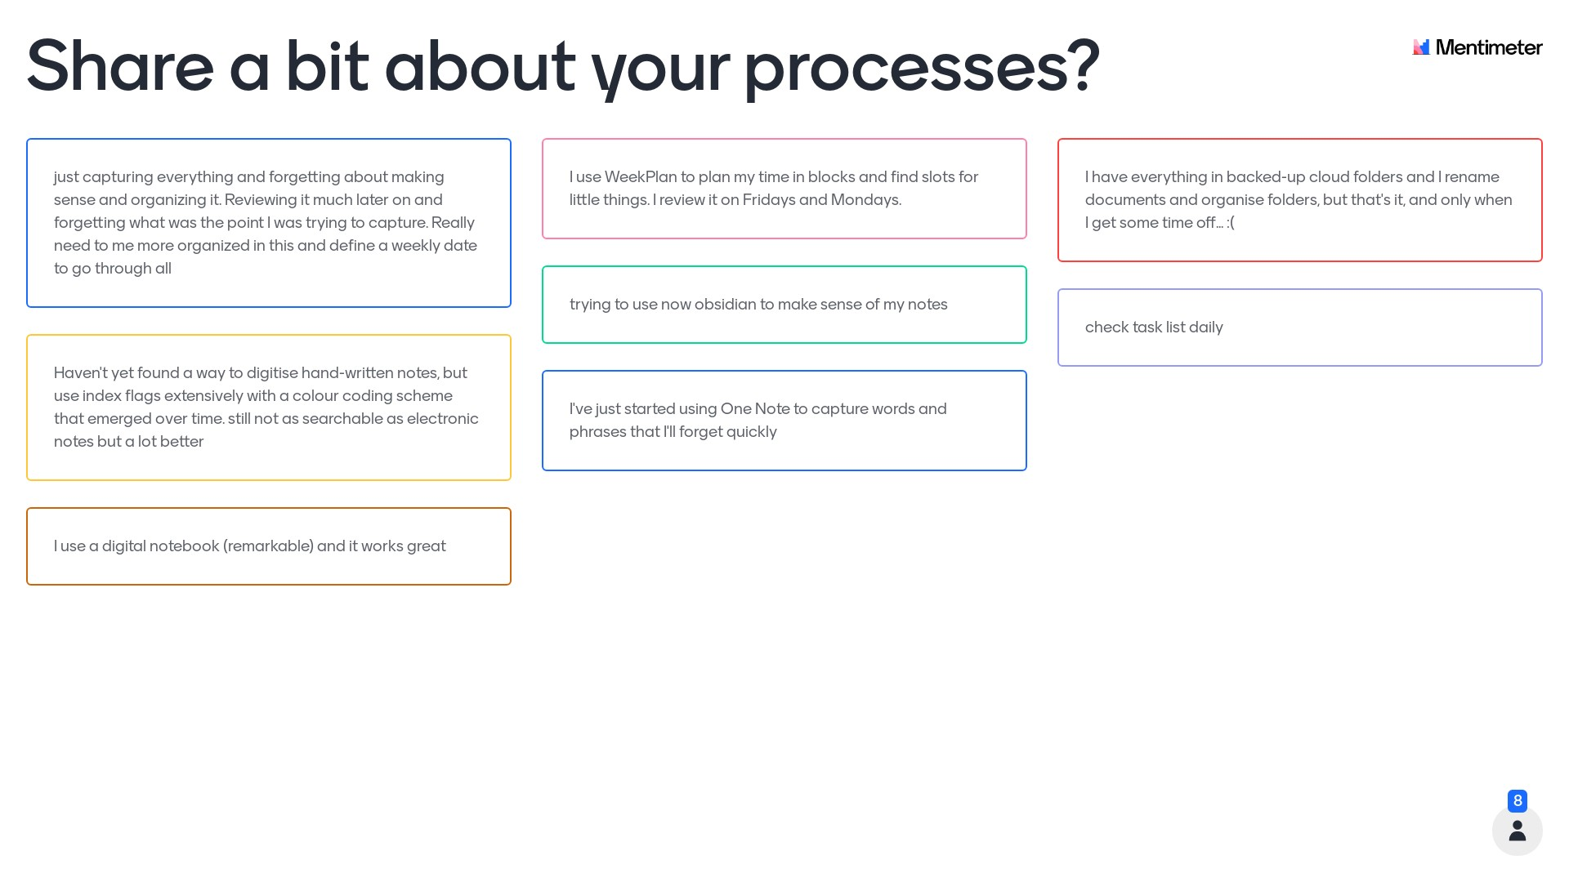
Talk about your combining/sorting processes

Slide 15
Refine turns ‘captured’ into ‘actionable’
Spend some time figuring out :
What a successful output or ending looks like (or what is a stopping point)
What needs to happen (and in what order?) to reach that ending
What needs to be learned/researched
What resources are needed/who has them/how to get them
Who needs to be consulted/involved/informed
Etc.
This steps should produce action items like “Identify a suitable publication” or “get the finance code for the expenses” or “ask Chris about sitting on the advisory committee”.
Notes:
This is the process of turning vague hand-waving, late night items into actual projects ideas and tasks by breaking it into parts that are linked and/or ordered.
It takes time and you probably won’t get it all done quickly or in one go.
You should end up with action items, although you will not always be in a position to turn everything into the same kind of “action item”. It is ok to end with some action items such as “spend an hour thinking about this” or “check with the team about this to see if they know what the action items should be”

Slide 16
Action!
If you can do it quickly (less than 2 minutes), just do it.
If you can do it but not quickly, then schedule it to be done.
If cannot do it without another thing, schedule both the things.
Notes:
Importantly, some of the things you might need to schedule might be “Research how to do x” or “find out who to ask about y” so when you “schedule both things” that might look like “spend an hour researching how to do x” and “spend an hour trying to do x” or “call the office admin to ask who knows about y” and “reach out about y according to who the office admin says is the right person”

Slide 17
Organise = scheduling stuff you cannot do quick
What are the priority actions (necessary to do)
What are the urgent actions (need to be done first)
Who is doing what?
When are they being done?
Who or what is dependent on who/what?
Who is a resource if things go wrong?
Put it into calendars or to-do lists, Kanban boards, etc.
Keep those records.

Slide 18
Actually action the actionable items
This is actually doing the things that are scheduled.
Anti-procrastination tools are available.
Ask for help if you need it instead of just procrastinating.

Slide 19
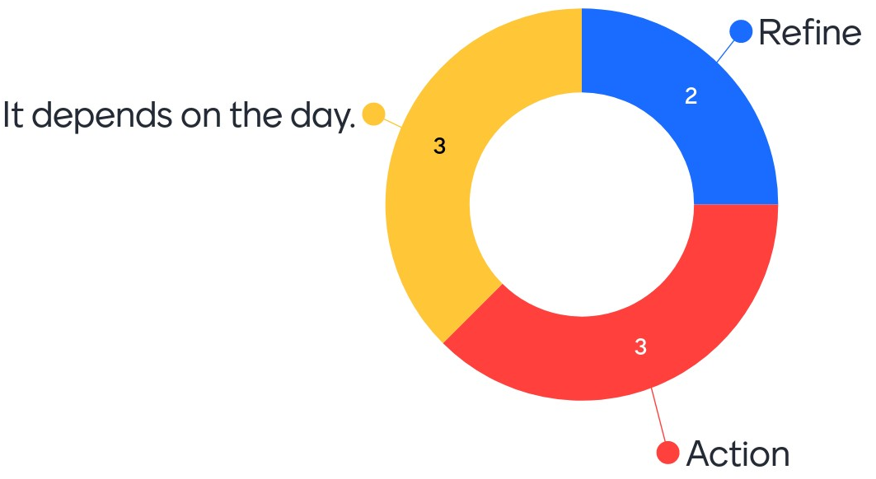
Which do you think is harder to do?

Slide 20
Reflect
What is working?
What are you proud of?
Write the reflections down.
Reflect on them occasionally.
Discuss them with people when you can.

Slide 21
The steps are not always totally separate
Collaborative work often is capture + combine + sort
Writing agenda and minutes are part of this
Checking the minutes/agreeing the action items is too
May need explicit follow ups to reflect on brainstorm outputs
Put everything in a central, accessible place
Make it easy for others (e.g. put a link to the doc in an email, mark the things you want them to check with their initials/in colour/etc.)
Put sessions in comms plan/calendars/to-do lists/Trello boards/etc.

Slide 22
Doesn’t GTD take a lot of time?
Not as much as you think.
It gets easier/faster with practice.
Protected time in your calendar = respected time.
Time spent on GTD is an investment in you.
Time invested = time and mental effort later
You come to know yourself better and thus act appropriately.
Notes:
1 and 2 – obvious
3. Marking things out on calendars means you can respond well to doodle polls, other people checking your calendar, etc. It also means other people see you working, get used to the idea that you have certain routines and respond to your habits.
4. This time is an investment in your mental health, your skills, your career development, your reputation, and your reproducibility.
5. This is because if you become the kind of person who knows what you have and where you have it, you are no longer the person who scrambles to find a quote or who second-guessing themselves or who panics because deadlines loom unexpectedly. No guarantees, but the more you get good at what you can do, the less you will struggle with what you can’t do.
6. You know your strengths and routines, you know your responses. You can judge effectively if today is a sort things mindlessly day, a review things in detail day, a call up other people and speak out loud day or a figure out how to do that thing by watching videos day. Knowing your self and giving your self time to be yourself is a kind of sophistication and/or joy.

Slide 23
Do these GTD habits help/hurt some researchers more than others?

Slide 24
Incentives

Slide 25
Use incentives
Get help from others
Pomodoro technique – 4 X 25 focus minutes + 5 break minutes
Reward yourself for any steps done, tasks done, or pomodoros
Alternate different kinds of tasks – creative tasks, detail tasks, menial tasks, physical tasks, etc.

Slide 26
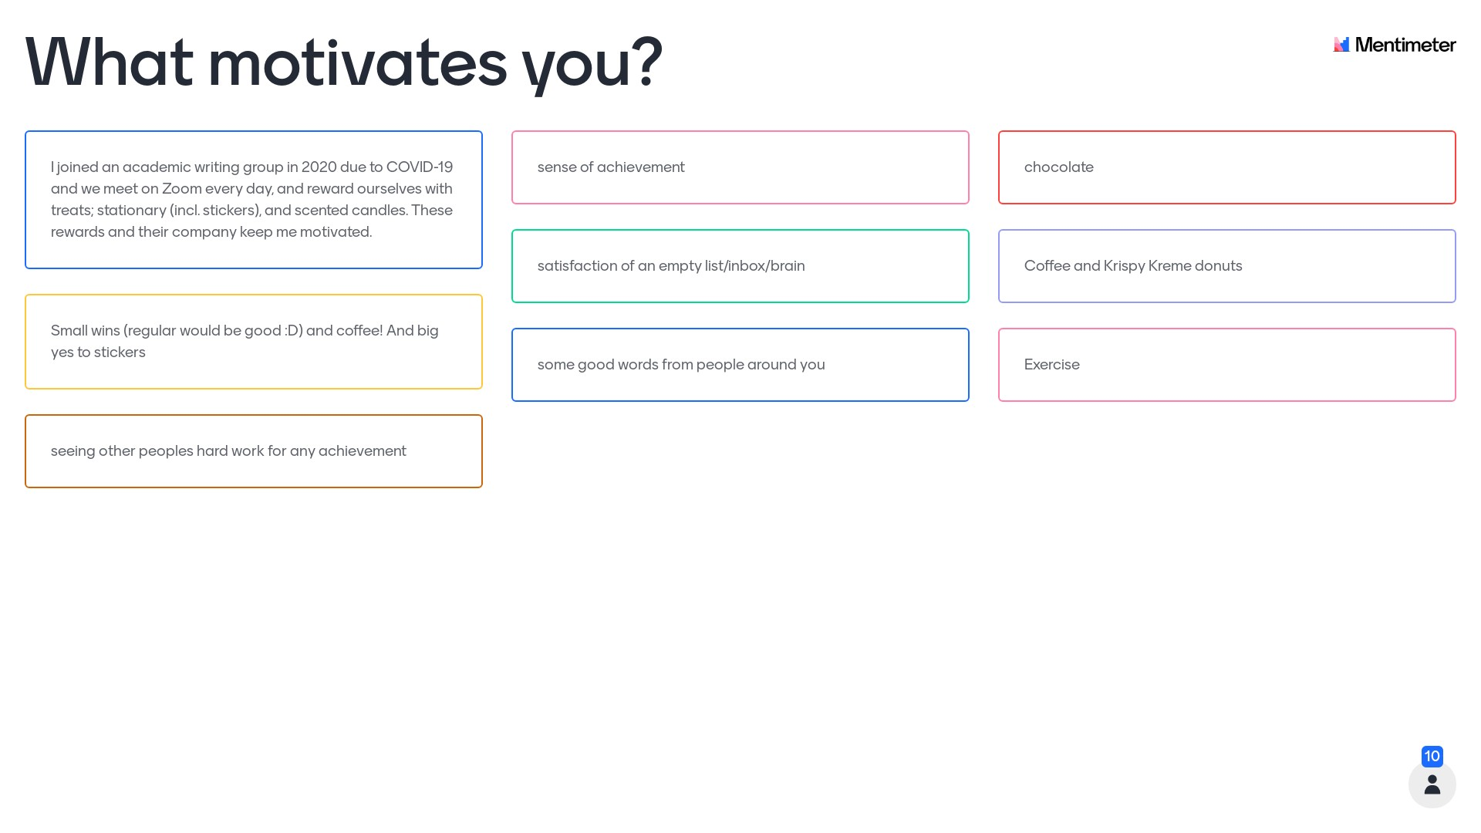
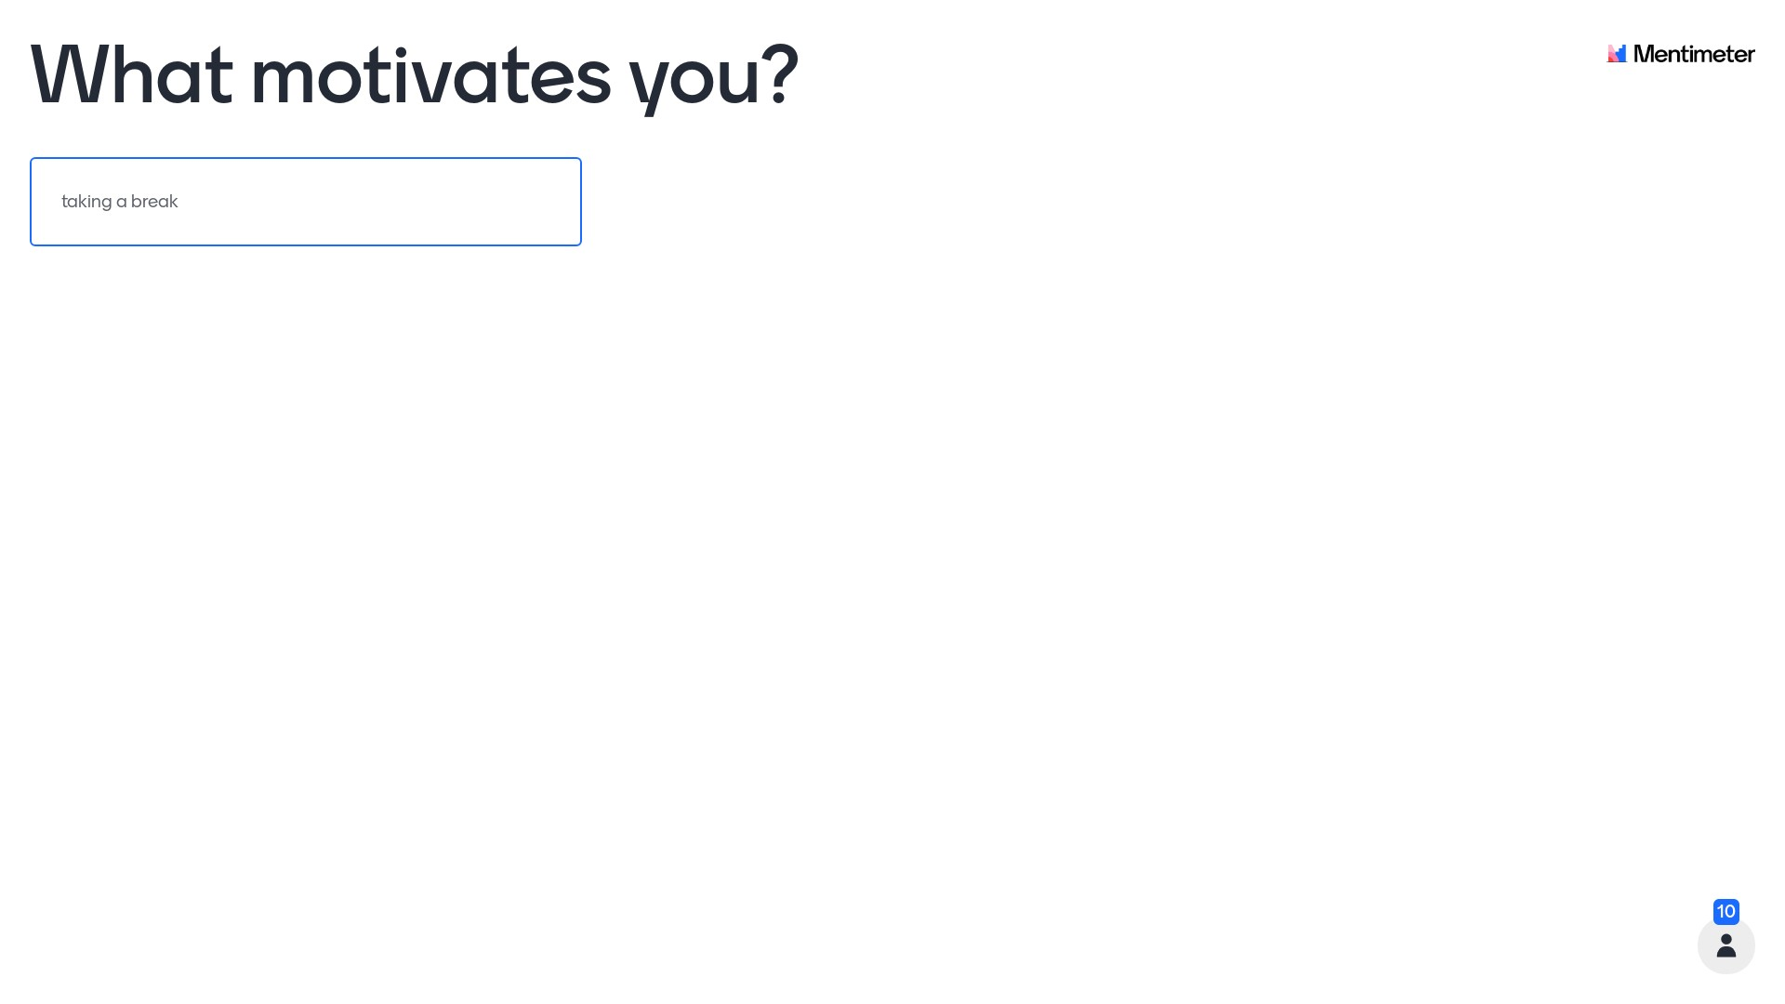
What motivates you?

Slide 27
Documentation must match purpose

Slide 28
Different purposes, different documents
Documentation is almost always better than no documentation
But what the documentation is used for is relevant
The lists of ideas you had in the middle of the night should not be treated the same as minutes of formal project meetings
The git log of your project is not referenced in the same way as your software version
Et cetera

Slide 29
Documentation by you, for you
Lots of the things you document may never be used or even seen by others
That doesn’t mean they are not useful to document because:
Can relieve your mind (out of my head, into my lists)
Create an evidence trail should there ever be some kind of formal complaint (always document anything remotely hinky)
Reassuring when you feel you’ve “done nothing”
Are useful to peruse when you go to brush up your CV
Lots of other reasons that may be quite personal

Slide 30
For you, by you
Spend less time looks*, more on function
Make it easy (or pleasant?) for you to use
Make sure you can get things out of it quickly/safely if needed
Plan for what happens to it if you are hit by a bus
You can tell others about your system (or share it) if useful (e.g. if you find yourself mentoring a junior colleague or leading a workshop on reproducibility)
* Unless you are motivated by how looks or find looks help it function

Slide 31
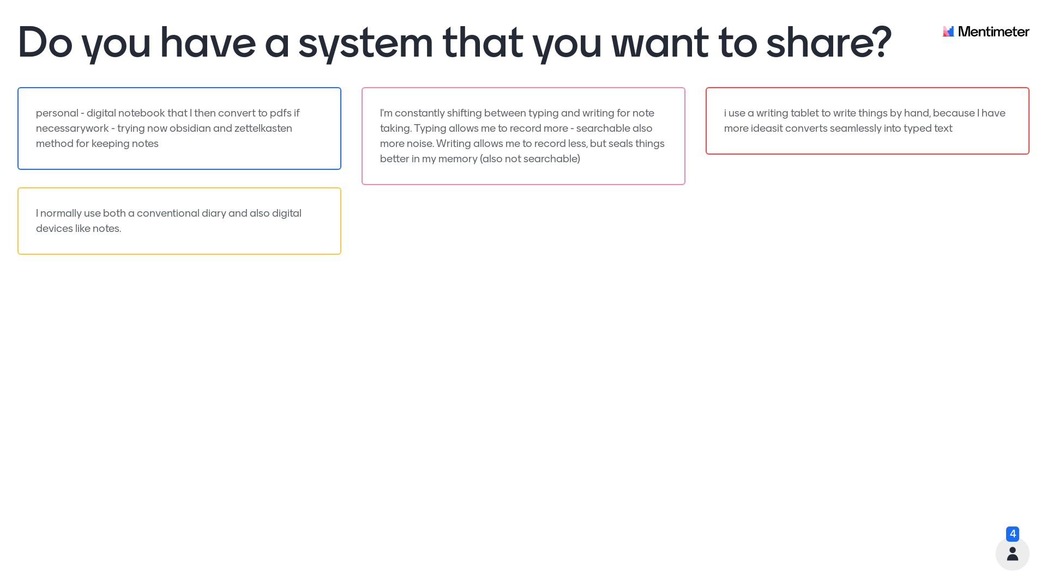
Reflect on your “for you by you” documentation

Slide 32
Documentation to stay in-team
Many things will only ever be seen/used briefly by your direct team
That doesn’t mean they are not useful to document because:
Necessary step to moving ideas forward to tangible products
Track credit/contribution for ideas to appropriate people/teams
Resource for sense check (especially after a holiday…)
Capture discussions that may turn into future work
Et cetera

Slide 33
Stay in-team
Locations and responsibilities agreed in comms plan
Check often it’s readable, works for everyone, everyone participates
Clarify what can/cannot be shared outside of the team
Needs a legacy plan (put it in comms plan?) to ensure the system still works if key players leave or the project is boxed up, etc.

Slide 34
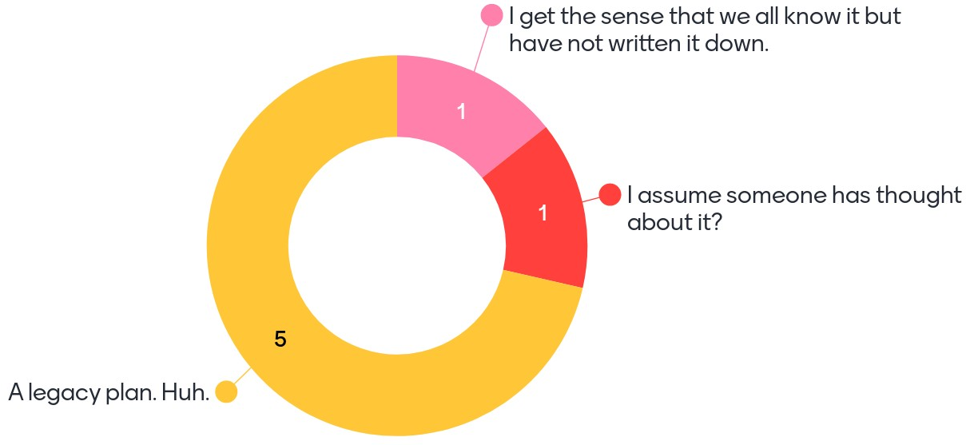
Do your projects always have a legacy plan?

Slide 35
Documentation to share with the boss
Fewer things will seen/used with formal structures
Ethics applications, funding bids, job extension requests, etc.
You need to keep these as well as the supporting documentation that produced them:
Things in formal documentation are not always as they appear
Formal requirements for you can mean formal support/approval too!
Et cetera

Slide 36
Share with the boss
Probably comes with specific forms, criteria, platforms, deadlines
Always keep copies for yourself
Ensure you are getting what you are owed as well as doing what you are required to do (formal agreements are always two-way streets)
You may want to share these with others as an example in the future (either with or without anonymisation) – e.g. funding bids are very useful for junior colleagues to see

Slide 37
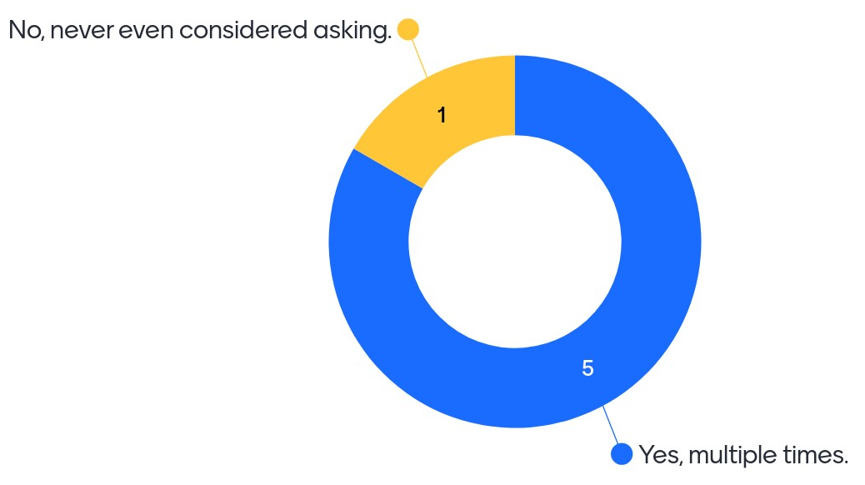
Have you ever requested a formal document from a colleague as an example?

Slide 38
Documentation to share with other researchers
Ideally, everyone would see your article/chapter/output
Final stage and working stages are different
Probably most won’t want to examine your code/raw data/etc.
But you should still document as if they would:
As much end-to-end process as possible
As much data/code/analysis/other as possible
No one has ever told me my code was ugly
A couple of really techy people were genuinely amazed that I published my entire research project in an interactive notebook.

Slide 39
Share with other researchers
Put it everywhere you can
Agree a legacy for this too if necessary (who is responsible for responding to requests for data/code in the future)
Don’t be embarrassed.
Don’t be embarrassed.

Slide 40
Do you think there are documentation barriers affect researches unevenly?

Slide 41
How to tell what kind of documentation it is?
Is it necessary to reproduce the work exactly ?
Is it helpful to reproduce the work in any way?
Are there any restrictions against sharing it?
Will it be useful to support you in some kind of claim/dispute?
Is it a massive hassle to make it suitable for public consumption?
Will it hurt you to share it?

Slide 42
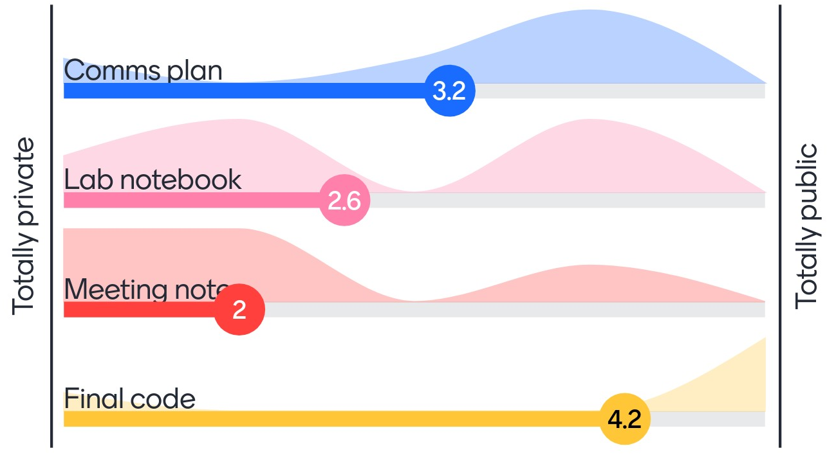
What level of sharing is right for this? 1

Slide 43
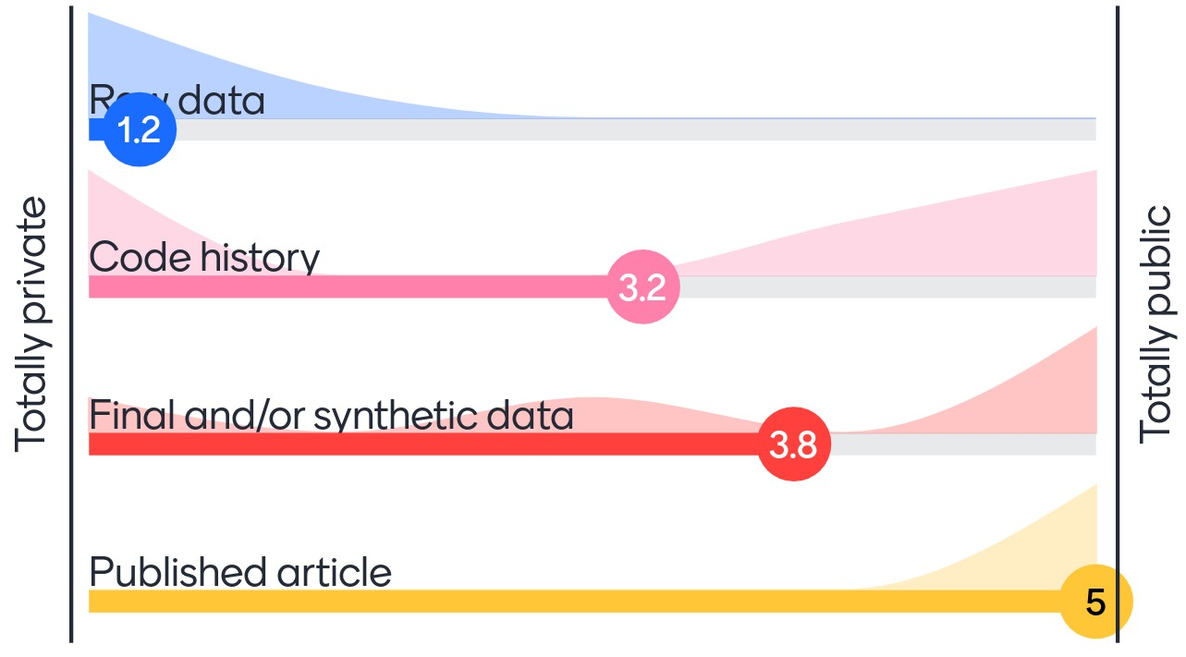
What level of sharing is right for this? 2

Slide 44
Organise your documentation
Schedule sessions to document in the comms plan?
Schedule time to work on documentation in everyone’s calendars/to-do lists/Trello boards/etc.
Document how often you document and how much time you spend on it (to know if you need to do it more often/less often/get other people involved/etc.)

Slide 45
Processes are never done
Consider the legacy
Sometimes things blow up unexpectedly (and much later)
Take time to reflect on what was done/how/when/etc.
Maintain contact with collaborators (if possible) to make it easier to reflect collaboratively
Share what went well on the project as well as what went well in the process – e.g. you may get invited to speak to early career researchers about how to collaborate and that will be a lot easier to do if you are already in the habit of reflecting on your collaborative projects

Slide 46
When to stop documenting

Slide 47
When to stop documenting
Do not document/share anything that you do not have a right to document/share
E.G. ask to record interviews, ask if people are happy to be listed as corresponding author, etc.
This should be part of your ethics applications, data management plans, etc.

Slide 48
Also, stop documenting when…
You are spending more time on the documentation than on the actual work.
If you find the documentation to workflow balance is off, try:
Automating the boring stuff
Using better tools/processes
Scaling back/rescoping the project
Recruiting help for sanity checks
Other suggestions?

Slide 49
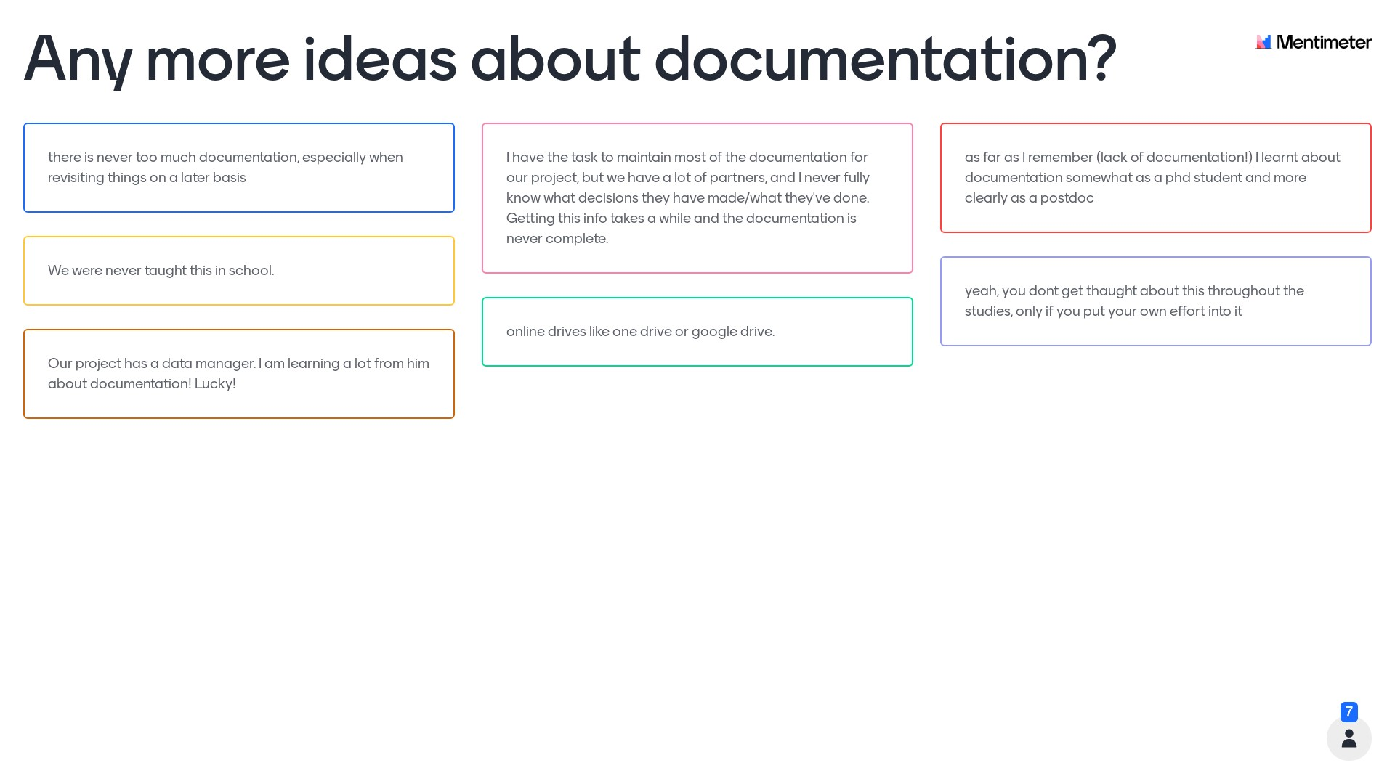
Any more ideas about documentation?

Slide 50
Modern pace of technological change

Slide 51
Modern tools, modern problems
Tools are made or discontinued at a rapid pace
Software is updated frequently, complicating versions/dependencies
Methods are developed continuously, but are not always very accessible
Plus, cultish adherence/avoidance
You can automate the boring stuff to do more than was feasible before
But automated processes can break easily

Slide 52
Ignorance can be fixed, but not everything can
Rapid pace of change and increased complexity mean = lack of skills or knowledge
Fixing this is possible, but not always easy
Openness to change is harder because it is often a (nearly) fixed feature of personality

Slide 53
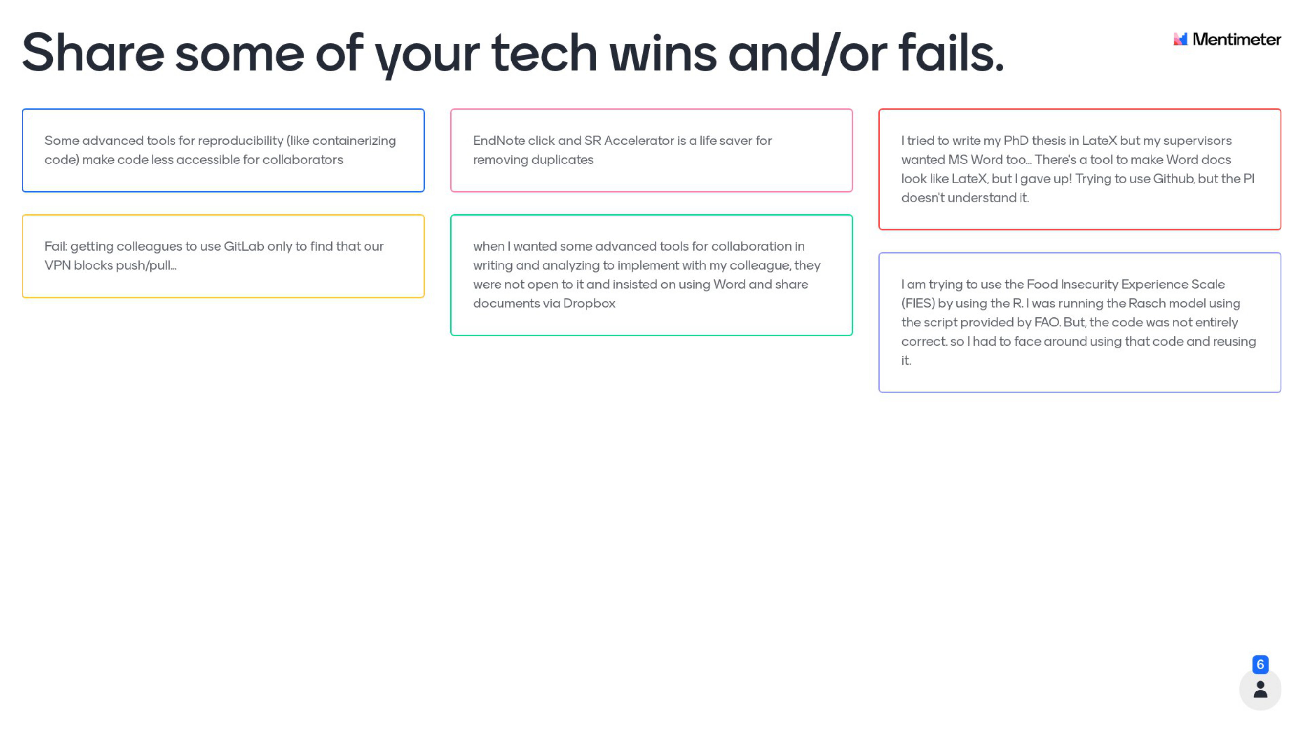
Share some of your modern tool problems
Notes:
Short answer/discussion about how their experiences.

Slide 54
Collaboration is complicated by…
Working across disciplines/institutes/etc. due to different:
Language
Terminology
Platforms
Requirements
Traditions
Etc.

Slide 55
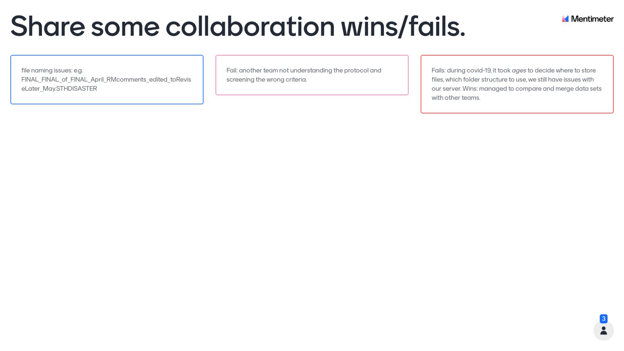
Share some of your collab wins and/or fails
Notes:
Short answer/discussion about how their experiences.

Slide 56
Anything more about how these issues might play out inequitably for some researchers?

Slide 57
References
Falk Huettig, Régine Kolinsky & Thomas Lachmann (2018) The culturally coopted brain: how literacy affects the human mind, Language, Cognition and Neuroscience, 33:3, 275-277, https://doi.org/10.1080/23273798.2018.1425803
Demoulin, C., Kolinsky, R. Does learning to read shape verbal working memory?. Psychon Bull Rev 23, 703–722 (2016). https://doi.org/10.3758/s13423-015-0956-7
Wikipedia community. (2022). "Getting Things Done." Retrieved 21/03/2022, from https://en.wikipedia.org/wiki/Getting_Things_Done.
Wikipedia community. (2022). “Pomodoro Technique.” Retrieved 02/05/202, from https://en.wikipedia.org/wiki/Pomodoro_Technique.

Slide 58
Q&A

Slide 59
Breakout #2

